Slide 1
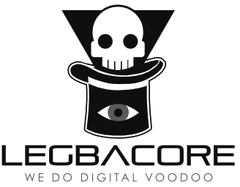
Advanced x86: BIOS and System Management Mode Internals UEFI SecureBoot
Xeno Kovah && Corey Kallenberg
LegbaCore, LLC

Slide 2
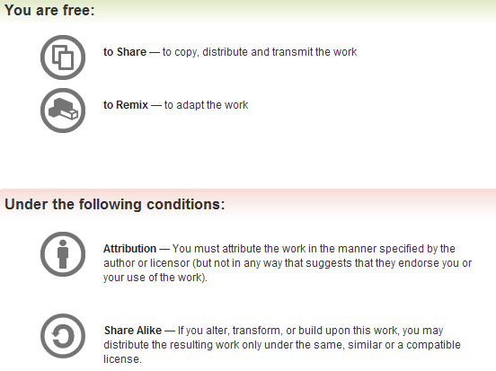
All materials are licensed under a Creative Commons “Share Alike” license.
http://creativecommons.org/licenses/by-sa/3.0/
Attribution condition: You must indicate that derivative work
"Is derived from John Butterworth & Xeno Kovah’s ’Advanced Intel x86: BIOS and SMM’ class posted at http://opensecuritytraining.info/IntroBIOS.html”
Notes:
Attribution condition: You must indicate that derivative work
"Is derived from John Butterworth & Xeno Kovah’s ’Advanced Intel x86: BIOS and SMM’ class posted at http://opensecuritytraining.info/IntroBIOS.html”

Slide 3
Intro to UEFI Secure Boot

Slide 4
Intro to UEFI Secure Boot
Verifies whether an executable is permitted to load and execute during the UEFI BIOS boot process
When an executable like a boot loader or Option ROM is discovered, the UEFI checks if:
The executable is signed with an authorized key, or
The key, signature, or hash of the executable is stored in the authorized signature database
UEFI components that are flash based (SEC, PEI, DXECore) are not verified for signature
The BIOS flash image has its signature checked during the update process (firmware signing)
Yuriy Bulygin, Andrew Furtak, and Oleksandr Bazhaniuk have the best slides that describe the Secure Boot process
http://c7zero.info/stuff/Windows8SecureBoot_Bulygin-Furtak-Bazhniuk_BHUSA2013.pdf (Black Hat USA 2013)

Slide 5
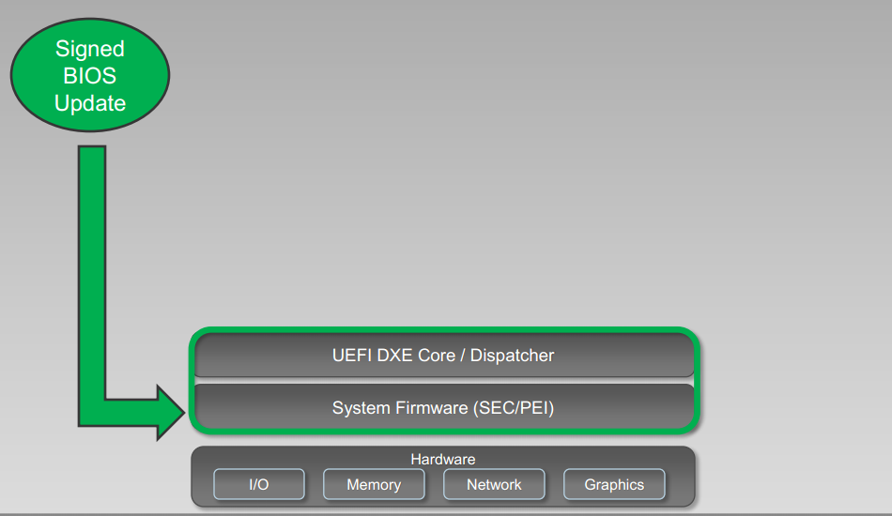
Firmware Signing
Flash-based UEFI components are verified only during the update process when the whole BIOS image has its signature verified
http://c7zero.info/stuff/Windows8SecureBoot_Bulygin-Furtak-Bazhniuk_BHUSA2013.pdf

Slide 6
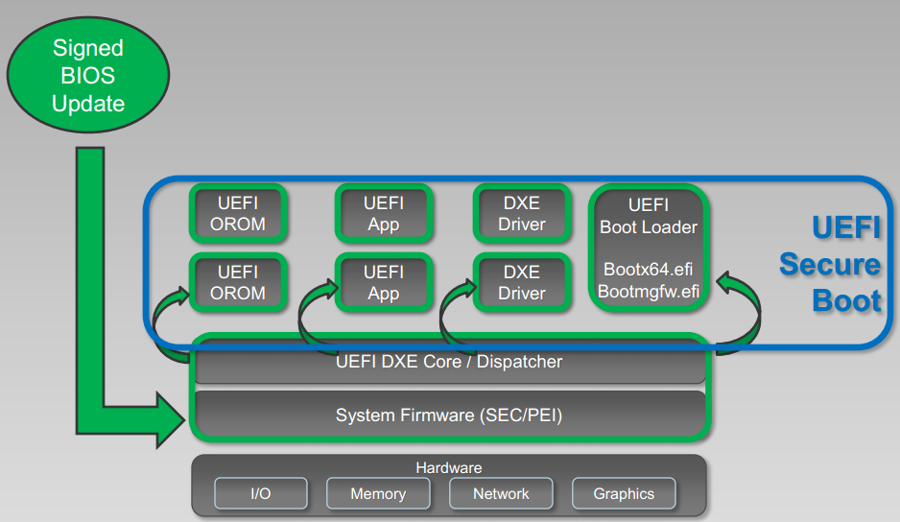
UEFI Secure Boot
DXE verifies non-embedded XROMs, DXE drivers, UEFI applications and boot loader(s)
This is the UEFI Secure Boot process
http://c7zero.info/stuff/Windows8SecureBoot_Bulygin-Furtak-Bazhniuk_BHUSA2013.pdf

Slide 7
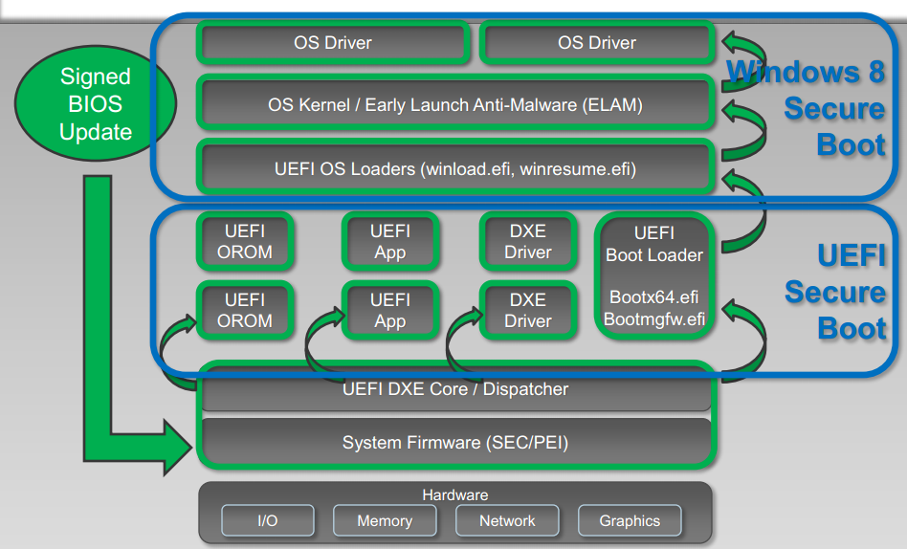
Windows 8 Secure Boot
Microsoft Windows 8 adds to the UEFI secure boot process
Establishes a chain of verification
UEFI Boot Loader -> OS Loader -> OS Kernel -> OS Drivers
http://c7zero.info/stuff/Windows8SecureBoot_Bulygin-Furtak-Bazhniuk_BHUSA2013.pdf

Slide 8
UEFI Variables (Keys and Key Stores)
UEFI implements 4 “variables” which store keys, signatures, and/or hashes:
Platform Key (PK)
Controls access to itself and the KEK variables
Only a physically present user or an application which has been signed with the PK is supposed to be able to modify this variable
Required to implement Secure Boot, otherwise the system is in Setup Mode where keys can be trivially modified by any application
Key Exchange Key (KEK)
Used to update the signature database
Used to sign .efi binaries so they may execute
Signature Database (DB)
A whitelist of keys, signatures and/or hashes of binaries
Forbidden Database (DBX)
A blacklist of keys, signatures, and/or hashes of binaries
UEFI Version 2.3.1, Errata C
Notes:
PK may be updated by an authentication descriptor signed with the platform key

Slide 9
UEFI Variables (Keys and Key Stores)
As stated earlier, these variables are stored on the Flash file system
Thus, if the SPI flash isn’t locked down properly, these keys/hashes can be overwritten by an attacker
The problem is, the UEFI variables must rely solely on SMM to protect them!
The secondary line of defense, the Protected Range registers cannot be used
The UEFI variables must be kept writeable because at some point the system is going to need to write to them
We saw this yesterday in the Charizard video where my colleague Sam suppressed SMI and wrote directly to the flash BIOS to add the hash of a malicious boot loader to the DB whitelist
Notes:
PK may be updated by an authentication descriptor signed with the platform key

Slide 10
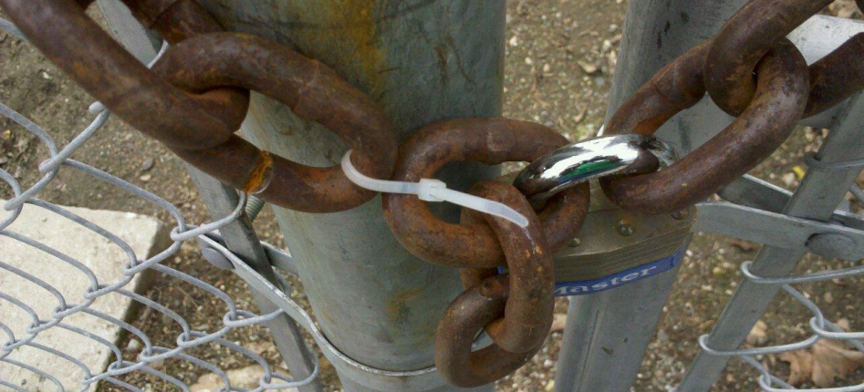
(Easy) Secure Boot Bypass
If signed firmware updates are not implemented properly, or if the SPI flash is not locked down properly, then Secure Boot can be trivially bypassed:
http://c7zero.info/stuff/Windows8SecureBoot_Bulygin-Furtak-Bazhniuk_BHUSA2013.pdf
Some takeaways from this presentation:
Unprotected flash means UEFI variables can be overwritten
Add a hash to the DB for a malicious boot loader, then attack the boot loader to load a modified kernel
Secure Boot can be disabled by corrupting the PK
And more! Check it out.

Slide 11
Secure Boot Bypass
From here on we’ll assume that firmware signing has been enabled properly and the flash is locked down
With that said, the firmware is still vulnerable
Now we’ll take a look at some vulnerabilities co-discovered by my colleague Corey Kallenberg and Yuriy Bulygin (Intel)
Presented first jointly with other Intel discoveries at CanSecWest 2013 as "All Your Boot are Belong to Us", and then later with the new material of Charizard at Syscan 2014 (and others) as "Setup for Failure: Defeating UEFI Secure Boot"

Slide 12
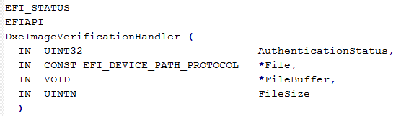
Secure Boot Signature Verification Policy
Depending on the source location of the file, the signature check may be skipped
When an image is discovered that needs to be authorized, the function ‘DxeImageVerificationHandler’ is called*
Located in the file DxeImageVerificationLib.c
*Code from EDK2 open source reference implementation available at: https://svn.code.sf.net/p/edk2/code/trunk/edk2

Slide 13
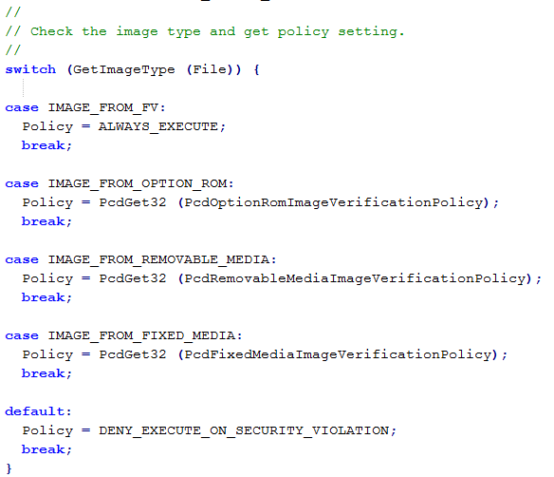
Policy: ALWAYS_EXECUTE
If an executable is located on a Firmware Volume (SPI Flash) then it is always executed without authorization
Makes sense assuming firmware signing is used and the BIOS flash was authorized prior to the update
GetImageType gets its return value from DXE services that locate the source of the executable, not from a value stored in the executable
Code from EDK2 open source reference implementation available at: https://svn.code.sf.net/p/edk2/code/trunk/edk2

Slide 14
Flexible Signature Checking Policy
These policy values are hard-coded in the EDK2
OEMs can modify them as they see fit
OEM’s can specify custom policies, different from the reference specifications
But they're likely not going to check everything from the FV at load time because that would be slow, and they have speed requirements they have to fulfill for their e.g. Windows 8 or Intel Ultrabook certifications
Code from EDK2 open source reference implementation available at: https://svn.code.sf.net/p/edk2/code/trunk/edk2

Slide 15
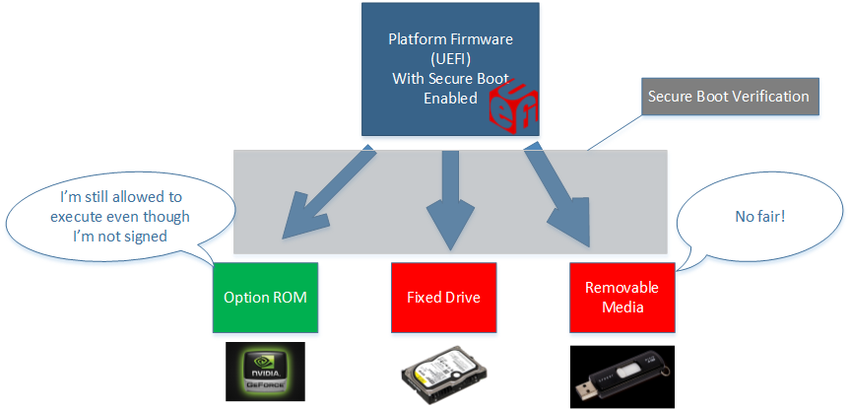
Flexible Signature Checking Policy
Theoretical example: An OEM allows unsigned Option ROMs to run to allow aftermarket PCI cards, like graphics cards, to work seamlessly

Slide 16
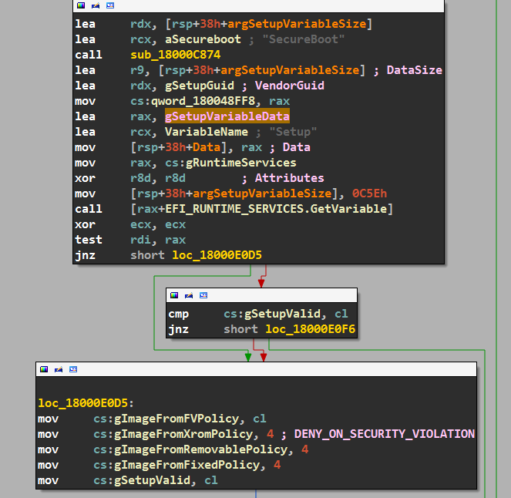
Secure Boot Policy
Each OEM will have their own secure boot policy
On the left is the disassembly of the secure boot policy initialization on a Dell Latitude E6430 BIOS revision A12
You’ll see that setup policy can come from either the flash NVRAM or be hardcoded in the BIOS
Defined by the “Setup” variable

Slide 17
Secure Boot Policy
gSetupValid determines whether to use the hardcoded secure boot policy, or if the policy embedded in the Setup variable should be used instead
If it doesn’t exist or it’s invalid, then the hardcoded values will be used

Slide 18
Default Hardcoded Policy
Default hard-coded policy regarding unsigned executables originating from:
Option ROMs: Deny
Removable Drives: Deny
Hard Drives: Deny
Firmware Volume: Allow

Slide 19

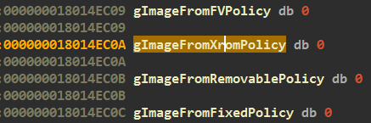
Setup Variables Offsets
The gSetupVariable data is loaded into memory at address 0x18014E0C0
Secure Boot policy data starts at offset:
gImageFromFvPolicy – gSetupVariableData = 0xB49 (to 0xB4C)
gSetupValid is at offset:
gSetupValid - gSetupVariableData = 0xC56

Slide 20
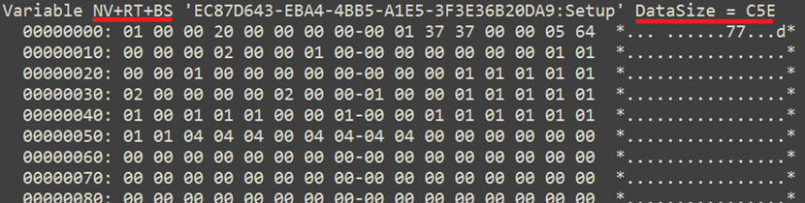
Setup Variable
Setup variable is marked as:
NV: Non-Volatile (Stored on flash chip)
RT: accessible to Runtime Services
BS: accessible to Boot services
Accessibility to Runtime Services means it should be modifiable from the operating system
0xC5E bytes long, chock full of stuff

Slide 21
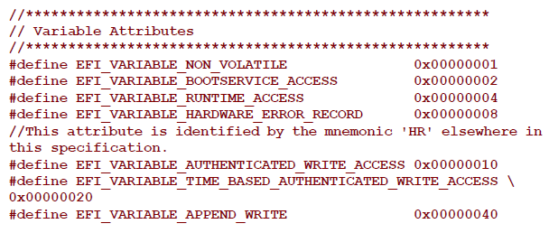
EFI Variable Attributes
Each UEFI variable has attributes that determine how the firmware stores and maintains the data:
‘Non_Volatile’
The variable is stored on flash
‘Bootservice_Access’
Can be accessed/modified during boot. Must be set in order for Runtime_Access to also be set
* UEFI 2.3.1 Errata C Final

Slide 22
EFI Variable Attributes
‘Runtime_Access’
The variable can be accessed/modified by the Operating System or an application
‘Hardware_Error_Record’
Variable is stored in a portion of NVRAM (flash) reserved for error records
* UEFI 2.3.1 Errata C Final

Slide 23
EFI Variable Attributes
‘Authenticated_Write_Access’
The variable can be modified only by an application that has been signed with an authorized private key (or by present user)
KEK and DB are examples of Authorized variables
‘Time_Based_Authenticated_Write_Access’
Variable is signed with a time-stamp
‘Append_Write’
Variable may be appended with data
* UEFI 2.3.1 Errata C Final

Slide 24
EFI Variable Attributes Combinations
If a variable is marked as both Runtime and Authenticated, the variable can be modified only by an application that has been signed with an authorized key
If a variable is marked as Runtime but not as Authenticated, the variable can be modified by any application
The Setup variable is marked like this

Slide 25
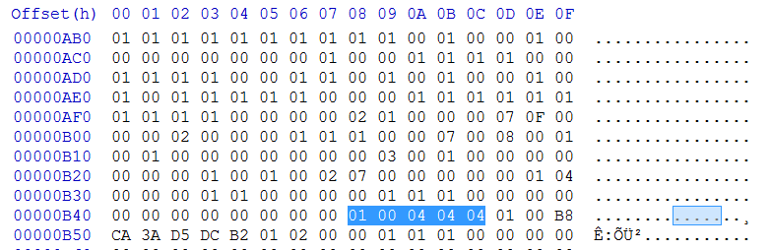
EFI Setup Variable Data
Using the offsets we calculated earlier we can locate the secure boot policy settings in the Setup variable
The Secure Boot policy settings started at offset 0xB49 from the start of the Setup variable data
Byte B49 contains the “IMAGE_FROM_FV” policy and is set to ALWAYS_EXECUTE (0x00)
Bytes B4A-B4C contain the policies pertaining to Option ROMs, Removable Storage, and Fixed Storage, respectively. All are set to “DENY_EXECUTE_ON_SECURITY_VIOLATION
We can change these to ALWAYS_EXECUTE (00)
Byte B48 contains the Secure Boot on/off value (on)

Slide 26
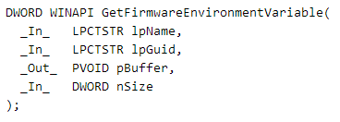
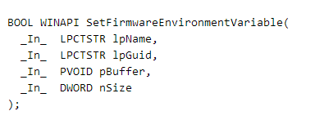
EFI Variable Access
Windows 8 provides an API to interact with EFI non-volatile variables
http://msdn.microsoft.com/en-us/library/windows/desktop/ms724934(v=vs.85).aspx
Because the Setup variable is marked as Runtime and not as Authenticated, we can modify it

Slide 27
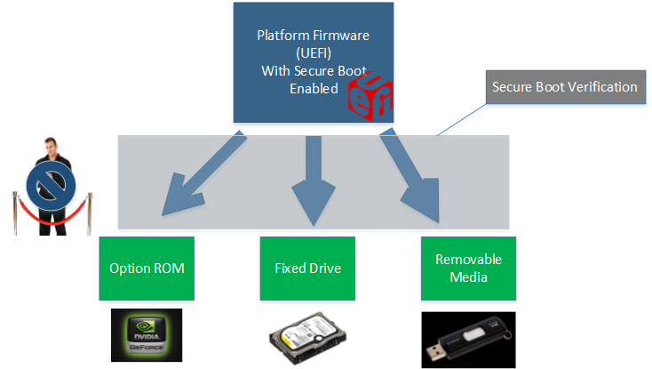
Result: Modified Secure Boot Policy
An unsigned executable will always be executed regardless of whether it is signed or unsigned, based on the ALWAYS_EXECUTE policy associated with them now

Slide 28
Attack 1 Summary
Malicious Windows 8 process can force unsigned executables to be allowed by Secure Boot
Exploitable from privileged application in userland
Bootkits will now function unimpeded
Secure Boot will still report itself as enabled although it is no longer “functioning”
That secure boot ‘on’ value was not modified
Co-discovered by Intel team

Slide 29
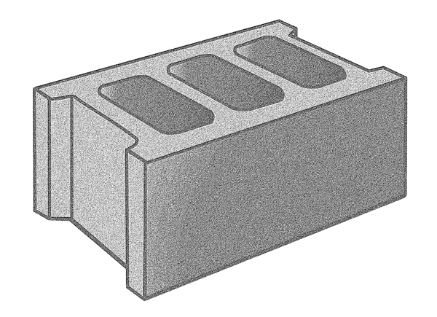
Attack 1 Addendum
Malicious Windows 8 privileged process can force can “brick” your computer if it just writes Setup to all 0s
Reinstalling the operating system won’t fix this
Intel didn't catch this and then we had to hold off on mentioning it until Hack in the Box AMS 2014

Slide 30
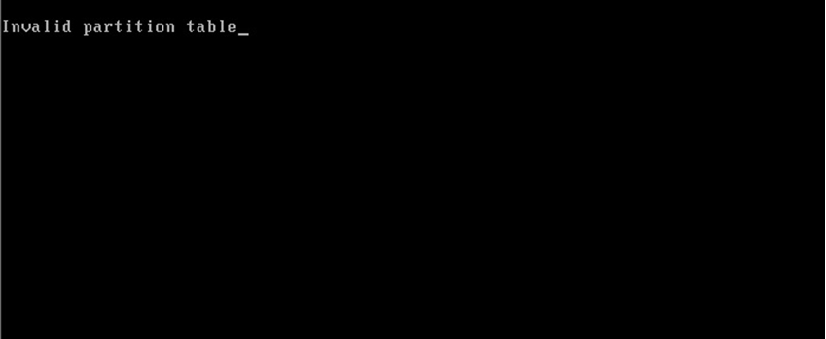
Attack 2: Delete Setup Variable
Typically, setting a variables size to 0 will delete it
Deleting the setup variable reverts the system to a legacy boot mode with secure boot disabled
This is also effectively a secure boot bypass, as it will force the firmware to transfer control to an untrusted MBR upon next reboot

Slide 31
Attack 2 Summary
Malicious Windows 8 process can disable Secure Boot by deleting “Setup” variable.
Exploitable from userland
Legacy MBR bootkits will now be executed by platform firmware
Secure Boot will report itself as “disabled” in this case
More easily noticeable than the previous attack

Slide 32
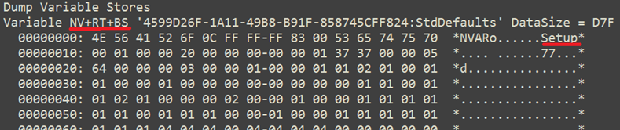
Attack 3: Modify StdDefaults Variable
Actually, when the firmware detects the “Setup” variable has been deleted, it attempts to restore its contents from the “StdDefaults” variable
This variable is also modifiable from the operating system, thanks to its non-authenticated and runtime attributes
So we can corrupt this too to ensure that UEFI always restores our evil version

Slide 33
Attack 3: Summary
Firmware would restore vulnerable Secure Boot policy whenever firmware configuration reverted to defaults
This could make life very difficult

Slide 34
Summary
CERT VU#758382
Vulnerability allows bypass of secure boot on many systems.
Co-reported by Intel and MITRE
We first identified this vulnerability on a Dell Latitude E6430.
Is this problem specific to the E6430?
Is this problem specific to Dell?
Is this vulnerability present in the UEFI reference implementation?

Slide 35
Summary
CERT VU#758382
Vulnerability allows bypass of secure boot on many systems.
Co-reported by Intel and MITRE
We first identified this vulnerability on a Dell Latitude E6430.
Is this problem specific to the E6430? No.
Is this problem specific to Dell? No.
Is this vulnerability present in the UEFI reference implementation? No.

